Slide 1
Batch Peak, Activity, and Shielding fitting in InterSpec
Automating in-situ analysis, common lab measurement, or analysis of larger datasets
Will Johnson
Org. 08647
20240930
UUR SAND2024-13419O

Slide 2
Some notes
This presentation is using the “bleeding edge” build of InterSpec, available as of 20240930
https://github.com/sandialabs/InterSpec/releases/tag/bleeding-edge
This is an automated build that gets updated every time code is pushed to the repository
For macOS, until a v1.0.13 release is made, see: https://github.com/sandialabs/InterSpec/releases/tag/20240911 (may be slightly different than this presentation)
All features in this presentation are expected to be in v1.0.13
This presentation also assumes basic working knowledge of using InterSpec
See https://sandialabs.github.io/InterSpec/ for tutorials and short use videos
This “batch” processing feature is brand new, and still being tested
Bug reports, feature requests, suggestions, and complaints are greatly appreciated!
InterSpec@sandia.gov

Slide 3
General Idea

Slide 4
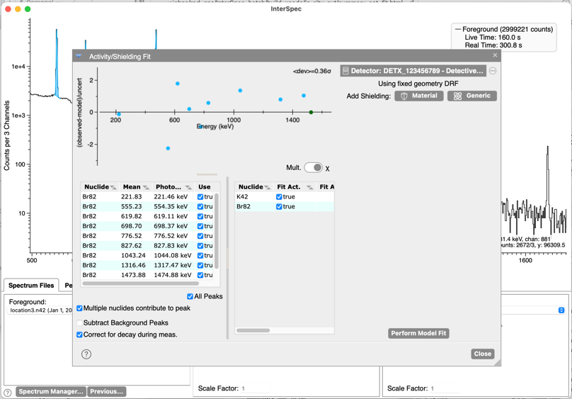
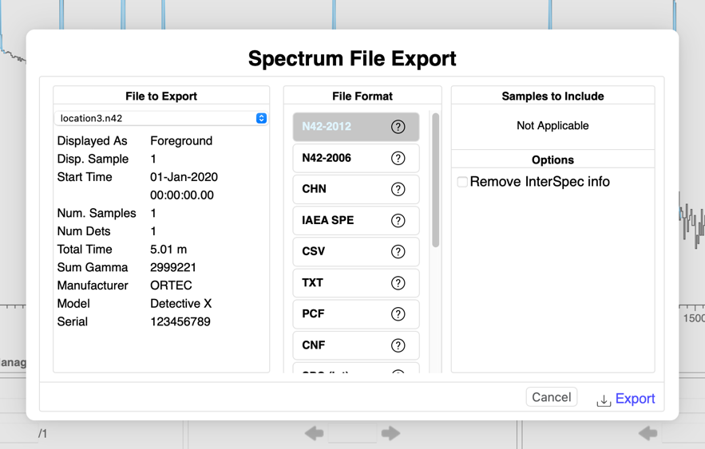
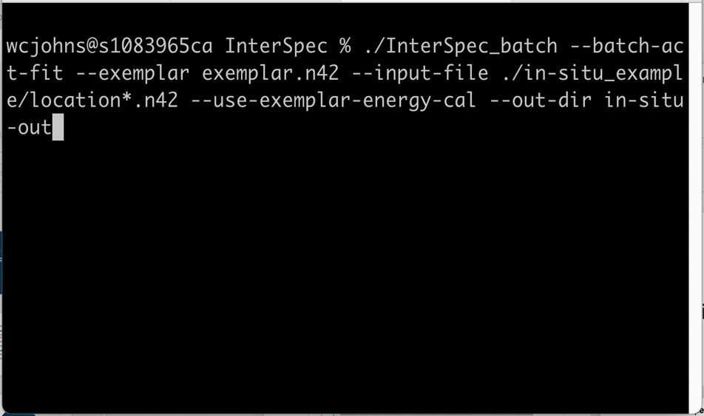
General Process
Assuming you have many similar measurements you would like to analyze, you would:
Perform an analysis, on a representative spectrum, referred to as the “exemplar”, as normal in InterSpec
Export the spectrum as a N42-2012 file. This will save all fit peaks, nuclide IDs, Energy calibration, detector efficiency function, and your Activity/Shielding fit, into a N42 file
From the command line, tell InterSpec_batch, where the exemplar file is, where the other input files are, and any other options – all other files will then be quickly analyzed in a similar fashion to the exemplar

Slide 5
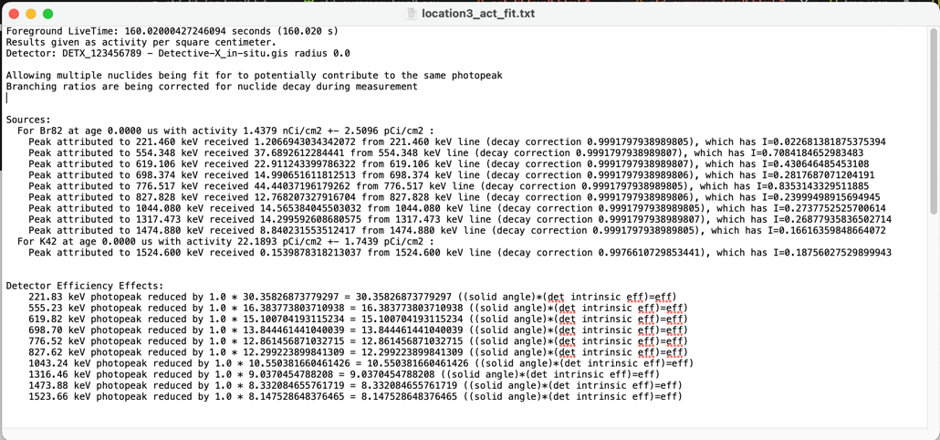
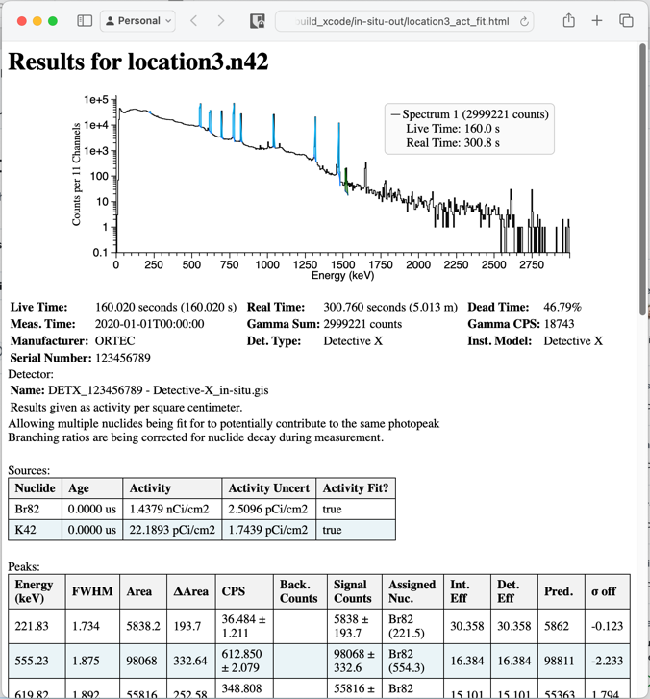
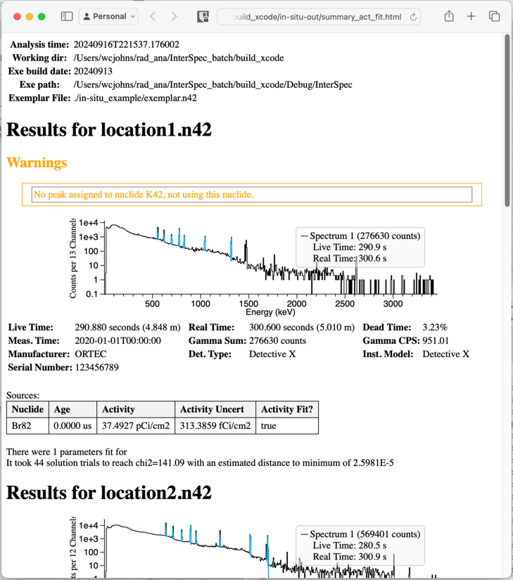
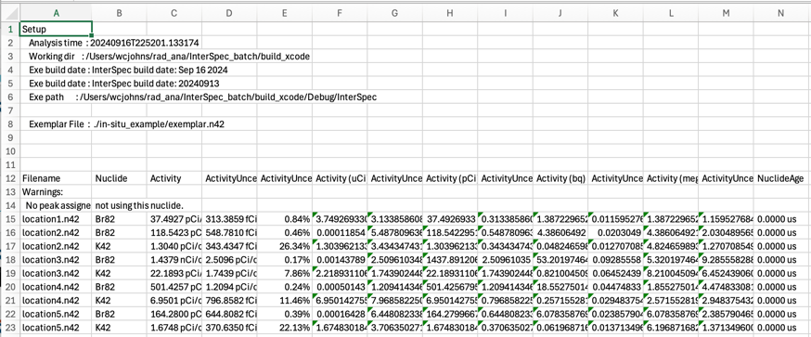
What you’ll get out – by default
For each input file, a CSV of peak fits
A text file, for each input-file, that contains results + lots of calculation details
For each input file, a stand-alone HTML file with tables of info, and an interactive spectrum (zoom in/out) you can inspect peak fits with
A single HTML file with spectra and results summary for all input files
A CSV file with analysis summary of all files
For each input file, peak fits are also saved to an N42 file.
You can also create custom report output format

Slide 6
Operations available for batch analysis:
All features of the Activity/Shielding fit tool can be used in batch mode
Fitting for activities, nuclide ages, accounting for interferences between nuclides, trace sources, self-attenuating sources, shielding thicknesses, spherical, cylindrical (end and side-on), and rectangular geometries, enrichments, etc
The energy calibration (that you possibly corrected) of the exemplar can be used with the other input files
You can also get minor updates to that by having the batch analysis fit for energy calibration based off the fit peaks
All peak-fitting possibilities are allowed (various peak skews, sharing ROIs, continua type, fixing FWHM, etc)
You can specify background file to either peak-by-peak subtraction, or a “hard” background subtraction (i.e., channel-by-channel)
You can also choose to just fit for peaks, instead of activities and such

Slide 7
Limitations of the batch analysis
Only peaks, and nuclides in the “exemplar” file are fit for
The activity and shielding fit setup has to be the same for all similar input files
You have to perform the analysis in the exemplar file first in InterSpec, and export to N42
Use and testing has so far been pretty limited – let us know if you find issues
The “Isotopics from peaks”, “Isotopics by nuclides”, “Detection Confidence Tool”, or “Flux Tool” have not been implements for batch analysis
Let InterSpec@sandia.gov know if these would be useful to you

Slide 8
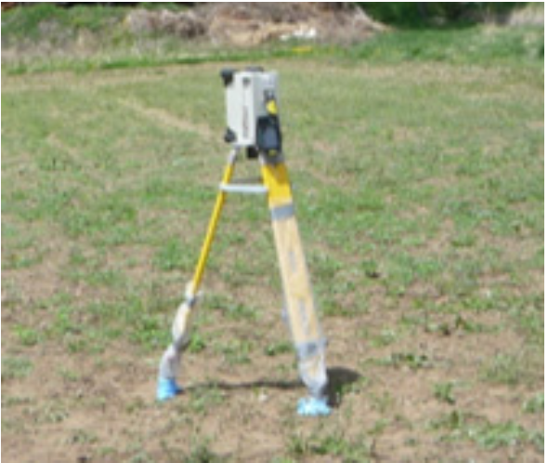
in-situ Example
Setup: there was a contamination event and in-situ measurements where taken at various places throughout the region, with a Detective-X detector, 1 meter from the ground, pointed down.
Please see the included “in-situ_example” directory for 5 data files, a background, and the “Detective-X_in-situ.ecc” file, which is the expected full-energy peak efficiency for the detector for surface contamination, computed using ISOCs
We will step through the batch analysis process in the following slides

Slide 9
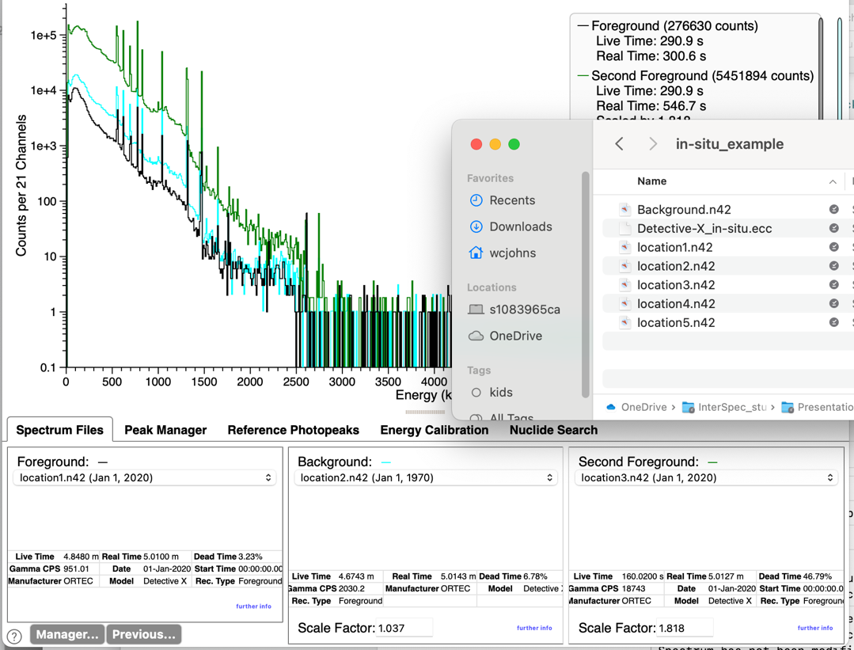
in-situ Example – Step 1: Pick Exemplar
Pick the file to use as as the “exemplar”
This file should have all the peaks you might want to use for activity analysis
Usually you can just quickly compare the spectra against each other, and use the file with the most peaks, if it even matters
After picking the “exemplar”, load that file as the foreground, using the “Spectrum Files” tab

Slide 10
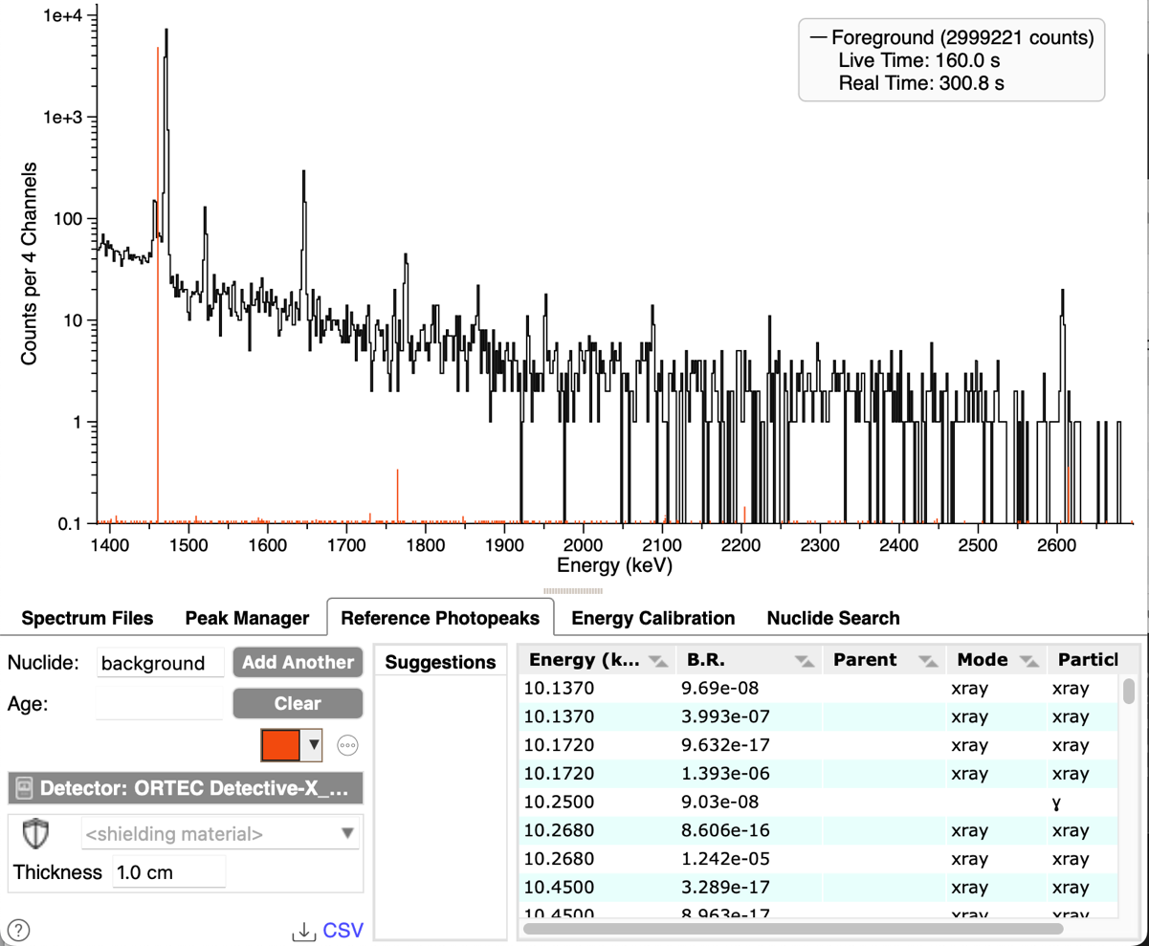
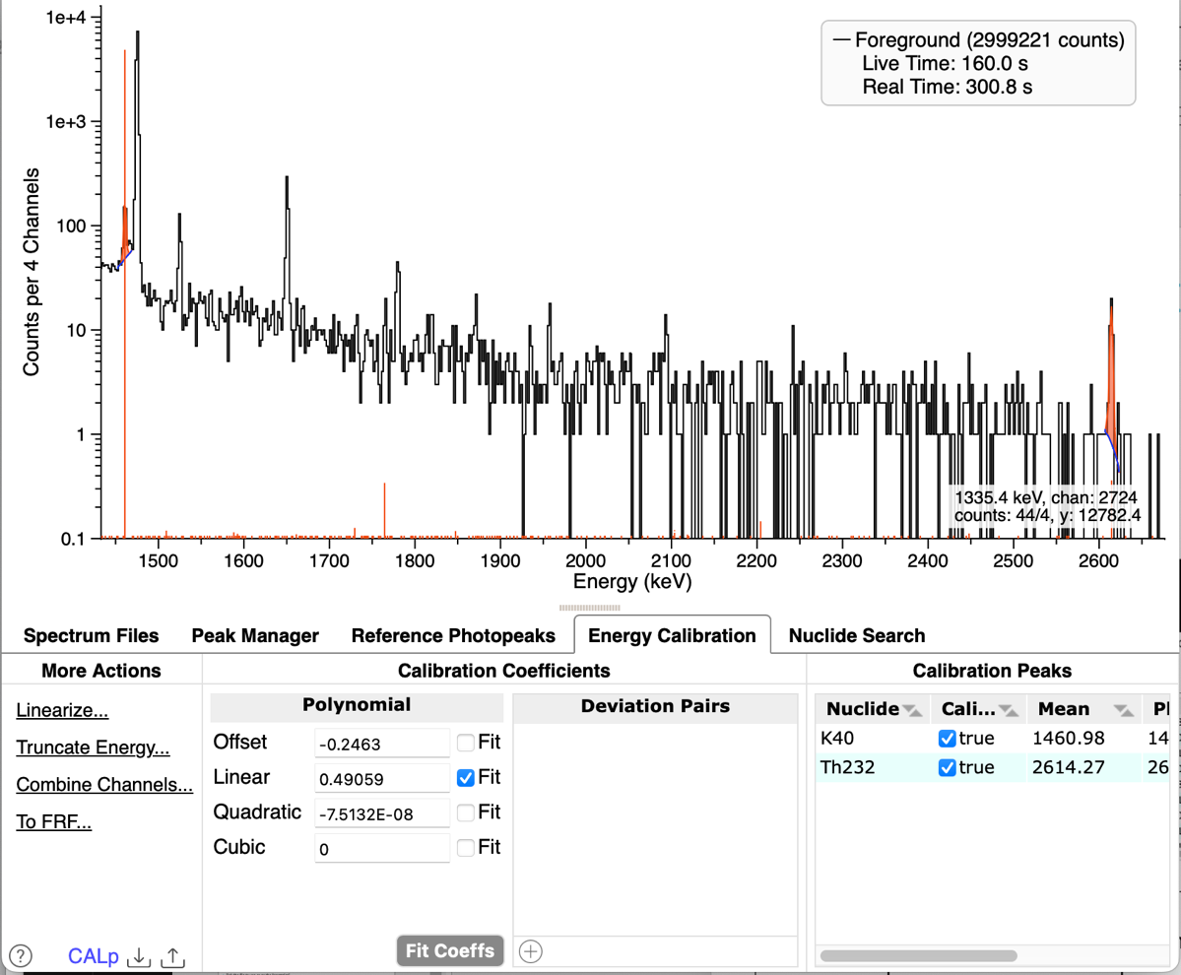
in-situ Example – Step 2: Check Energy Cal
Check, and fix, the energy calibration
For these spectra, show either the “background” or “K40” reference lines, and then double click on what should be the 1460 keV peak and/or 2614 keV peak
K40 should have been associated with the peak at ~1457 keV when you fit it, if you were showing the reference lines. If not, please associate K40 with the peak by using “Peak Editor”, or ”Peak Manager” tab. Similar for 2614 keV peak
Go to the “Energy Calibration” tab, and select to fit only the “Linear” energy calibration coefficient, then hit “Fit Coeffs” button

Slide 11
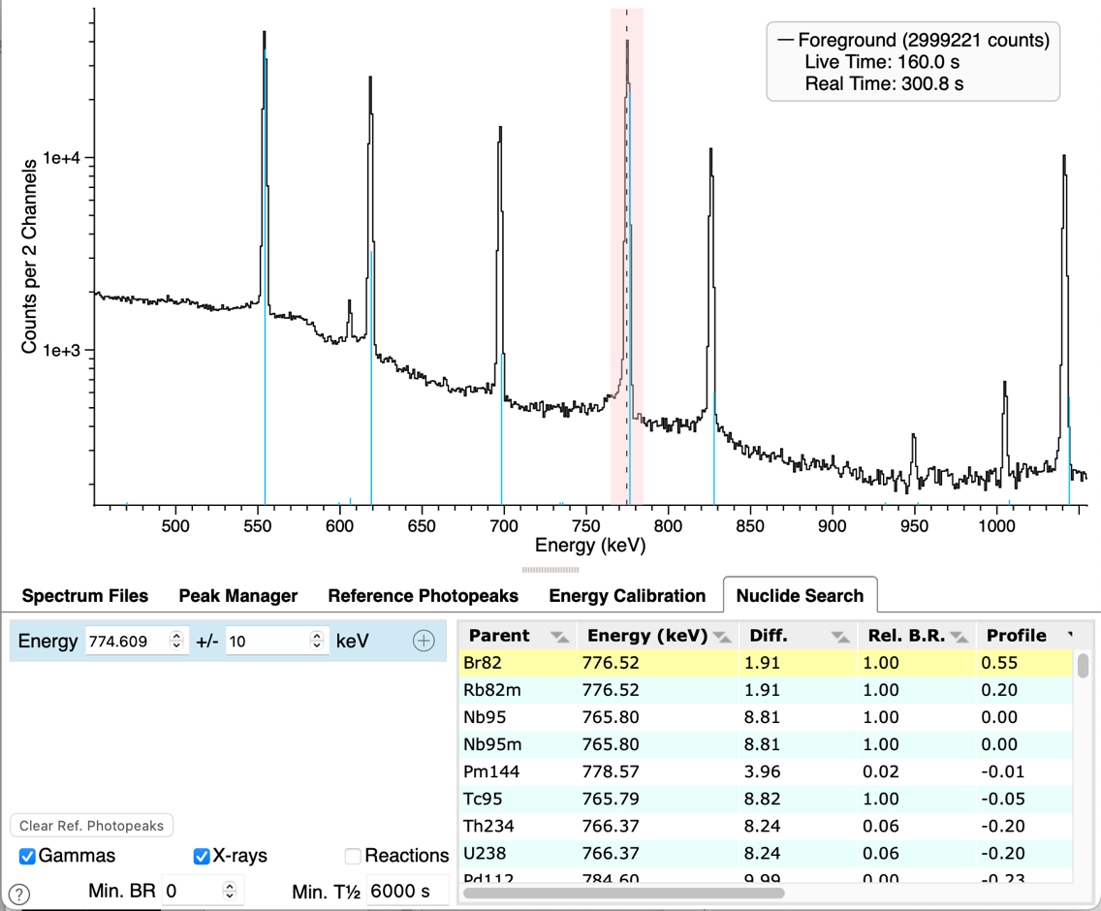
in-situ Example – Step 3: Nuclide ID
Select the “Nuclide Search” tab, and then click near the mean of one of the larger non-background peaks – this will fill this energy to search on, and the result table will populate
Click the different result rows to find which nuclide is a candidate – shown above the first result of Br82 matches well

Slide 12
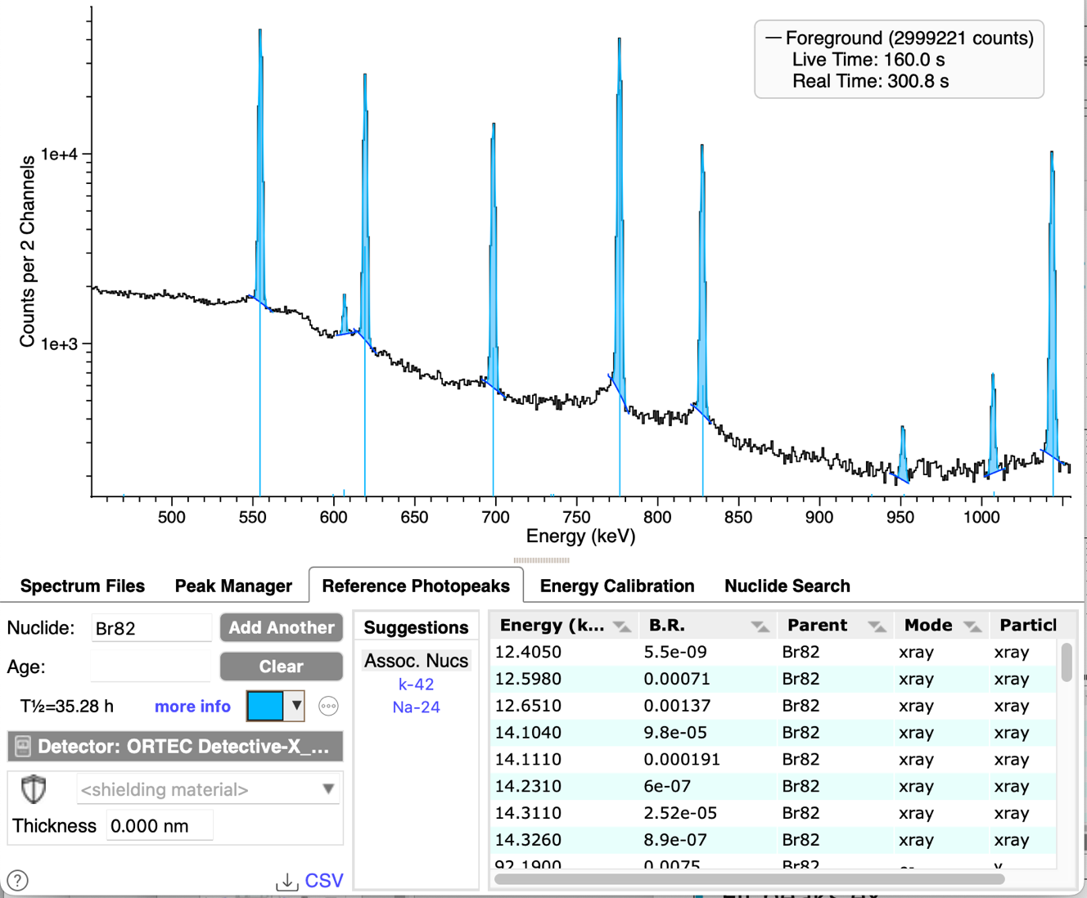
in-situ Example – Step 3: Peak Fit
Tip: clicking the “more info” link, and/or checking for the presence of associated nuclides is useful
Fit peaks explained by this nuclide
Usually double-clicking on the spectrum near the peak is good enough
You can also use the “Search for Peaks” button on the “Peak Manager” tab

Slide 13
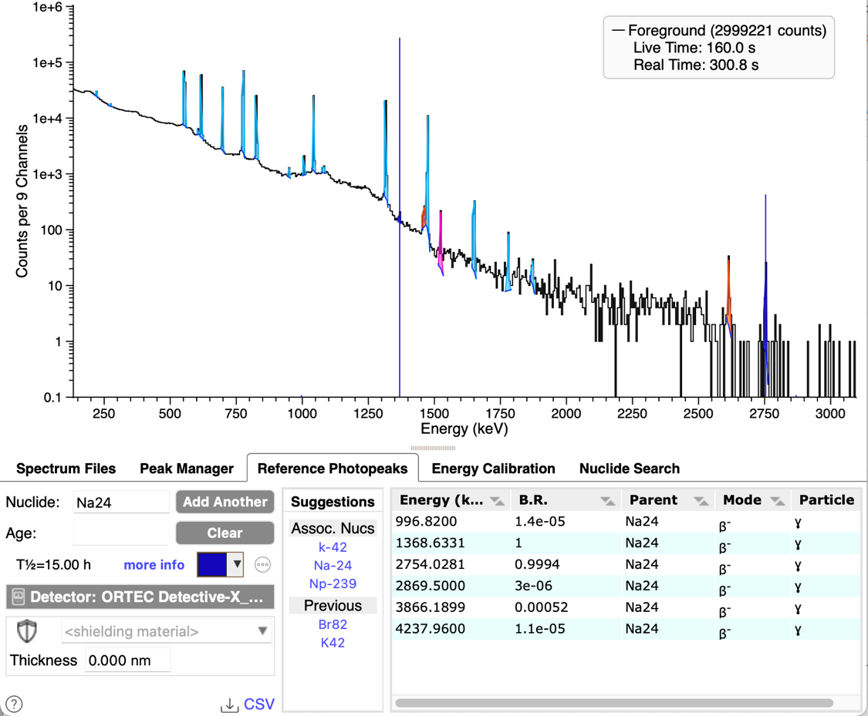
in-situ Example – Step 4: Repeat Steps 2 and 3
For any unidentified, non-background peaks, repeat steps 2 and 3, of performing nuclide ID and fitting the peaks
For this example, both K42 and Na24 that were shown as associated with Br82 are present

Slide 14
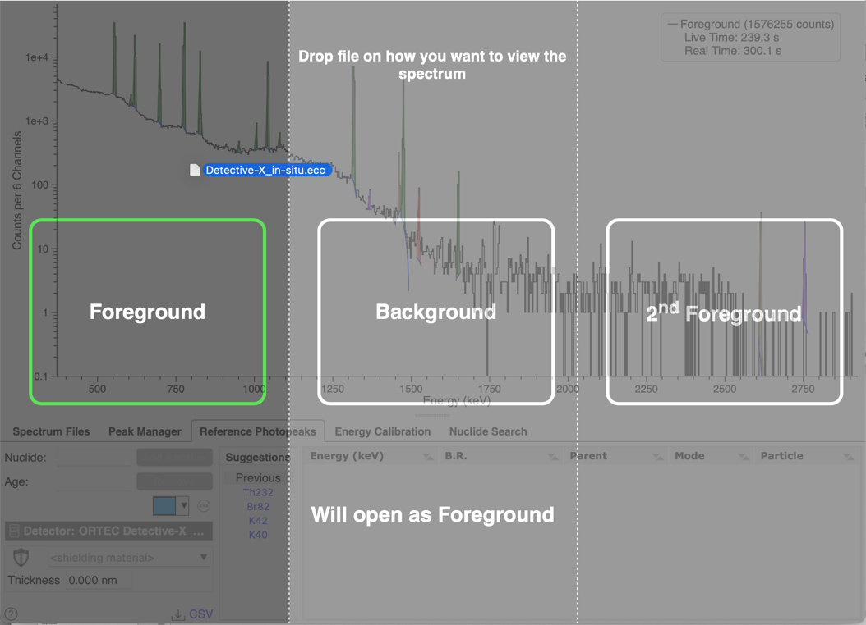
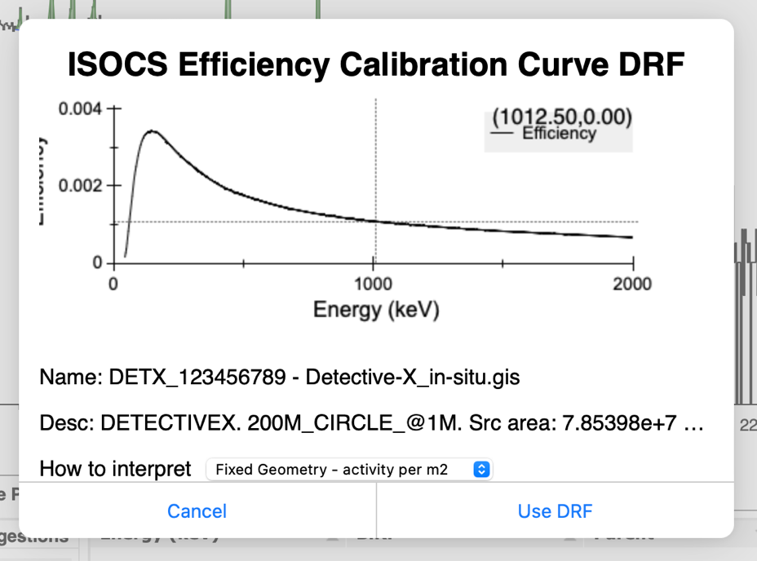
in-situ Example – Step 5: Load Detector Efficiency Function
Select this det. efficiency is for activity per m²
Drag-n-drop the “Detective-X_in-situ.ecc” file onto InterSpec
You will then get a dialog asking how to interpret this file
This efficiency was made to be in activity meter square meter in ISOCS.
Then click the “Use DRF” button
Note: InterSpec comes with many detector efficiency functions, or there are a number of other ways to load, or sources of, detector efficiency functions - this is example is specific to using an ISOCS result

Slide 15
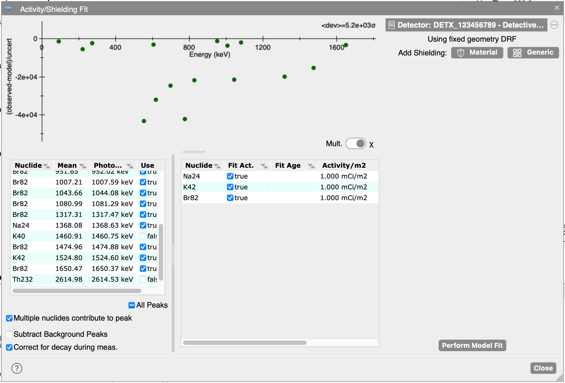
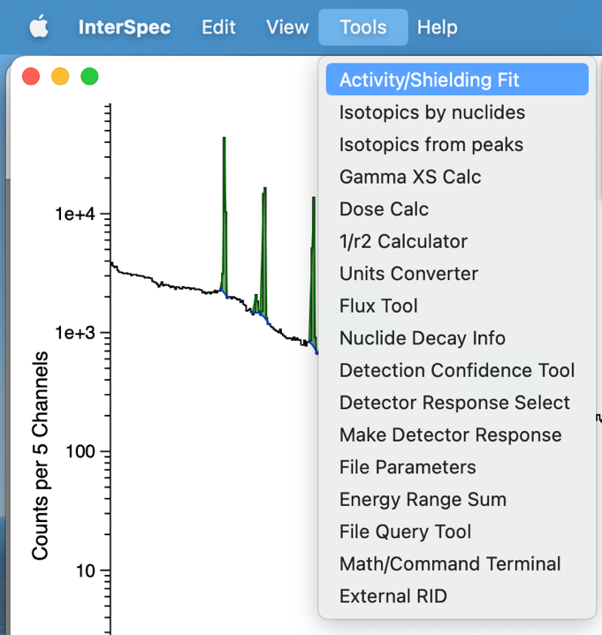
in-situ Example – Step 6: Fit Activities
From the tools menu, go to “Activity/Shielding Fit”
From left-hand side, select which peaks you would like to use
If you fit any background peaks, at a minimum, you probably want to de-select those
We don’t need any shielding, or background subtraction, nuclide ages, or anything else for this simple problem, but if your problem requires these things, you would set them up now

Slide 16
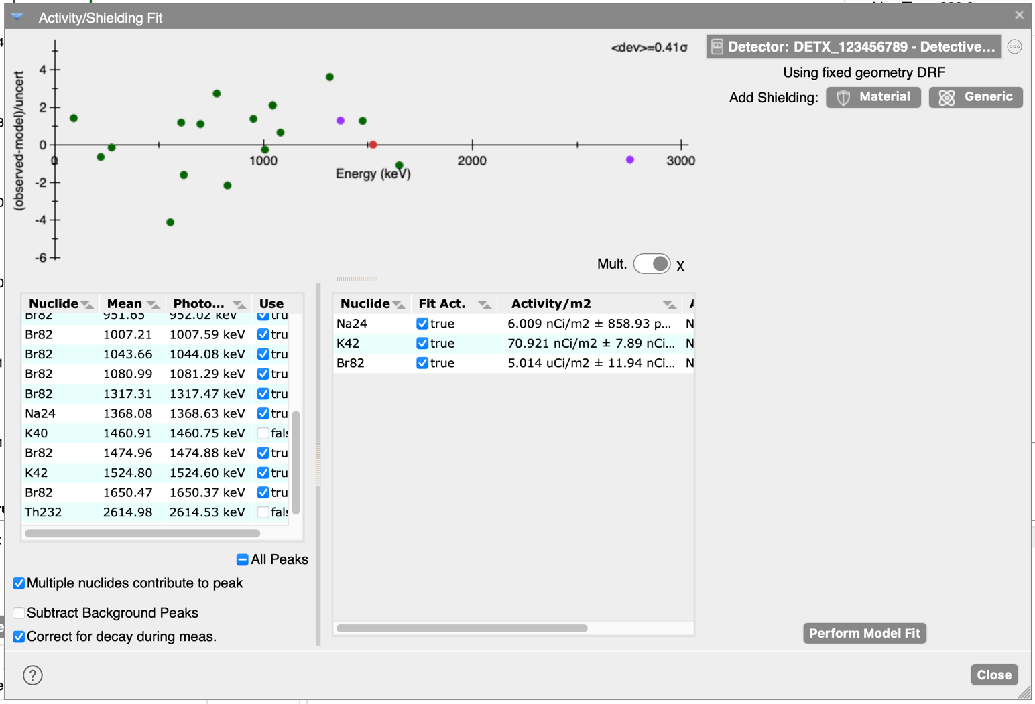
in-situ Example – Step 6: Fit Activities (cont)
These dots show within how many statistical sigma each peak is to the final answer – should be scattered between around ±5
Some people prefer to instead look at the activity multiple of each peak – use this switch here
The fit activities are here
Click “Perform Model Fit” button, and you should get something like the above
If you choose, you can use only a single peak for each nuclide, or you can use the weighted mean of more than one
The primary InterSpec author prefers to use all peaks, to make sure everything is consistent

Slide 17
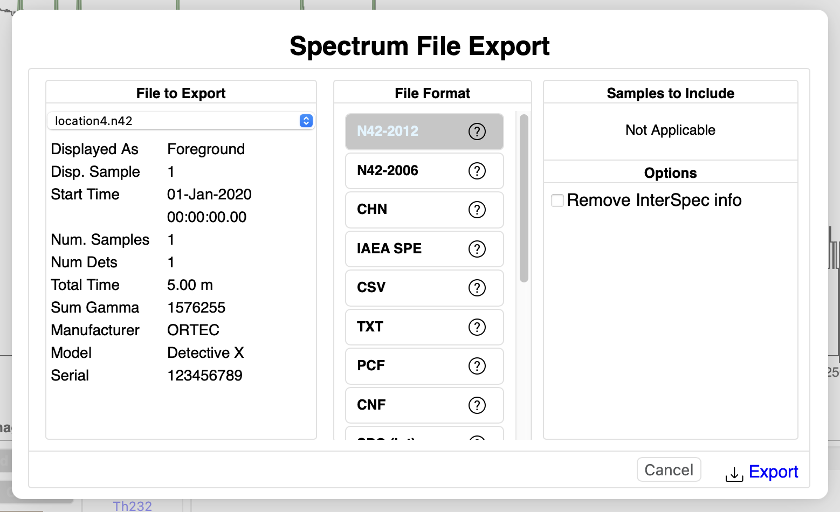
in-situ Example – Step 7: Export N42 File
Close the “Activity/Shielding Fit” tool, and go to InterSpec → Export File…
Select N42-2012 format (default), and then click the “Export” button
You may want to save the file with something like “exemplar” as the file name

Slide 18
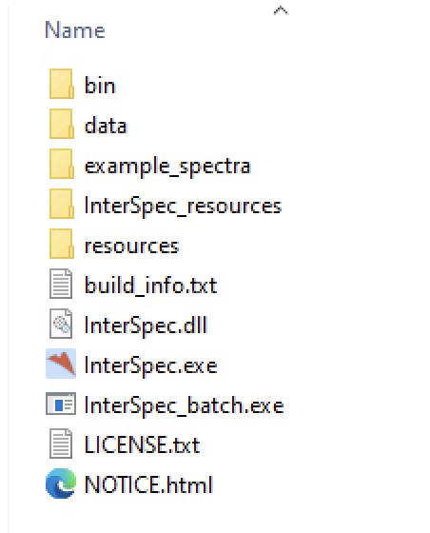
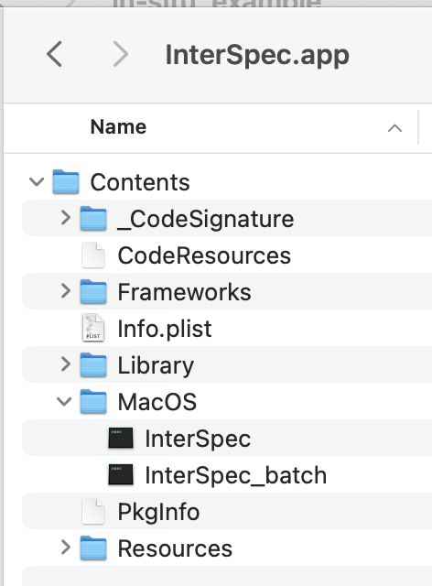
in-situ Example – Step 8: Run Batch Analysis
Starting with InterSpec v1.0.13, or “bleeding edge” builds in September of 2024, InterSpec comes with two executables, the normal GUI application, and “InterSpec_batch” to be used from the command line
“bleeding edge” build at https://github.com/sandialabs/InterSpec/releases/tag/bleeding-edge
On Windows “InterSpec_batch.exe” is right next to normal InterSpec.exe
On macOS, you would access it at /Applications/InterSpec.app/Contents/MacOS/InterSpec_batch
As of Sep. 2024, the Linux, or “Electron” build for Windows doesn’t support batch, but it is expected to just be the same executable as launches the GUI

Slide 19
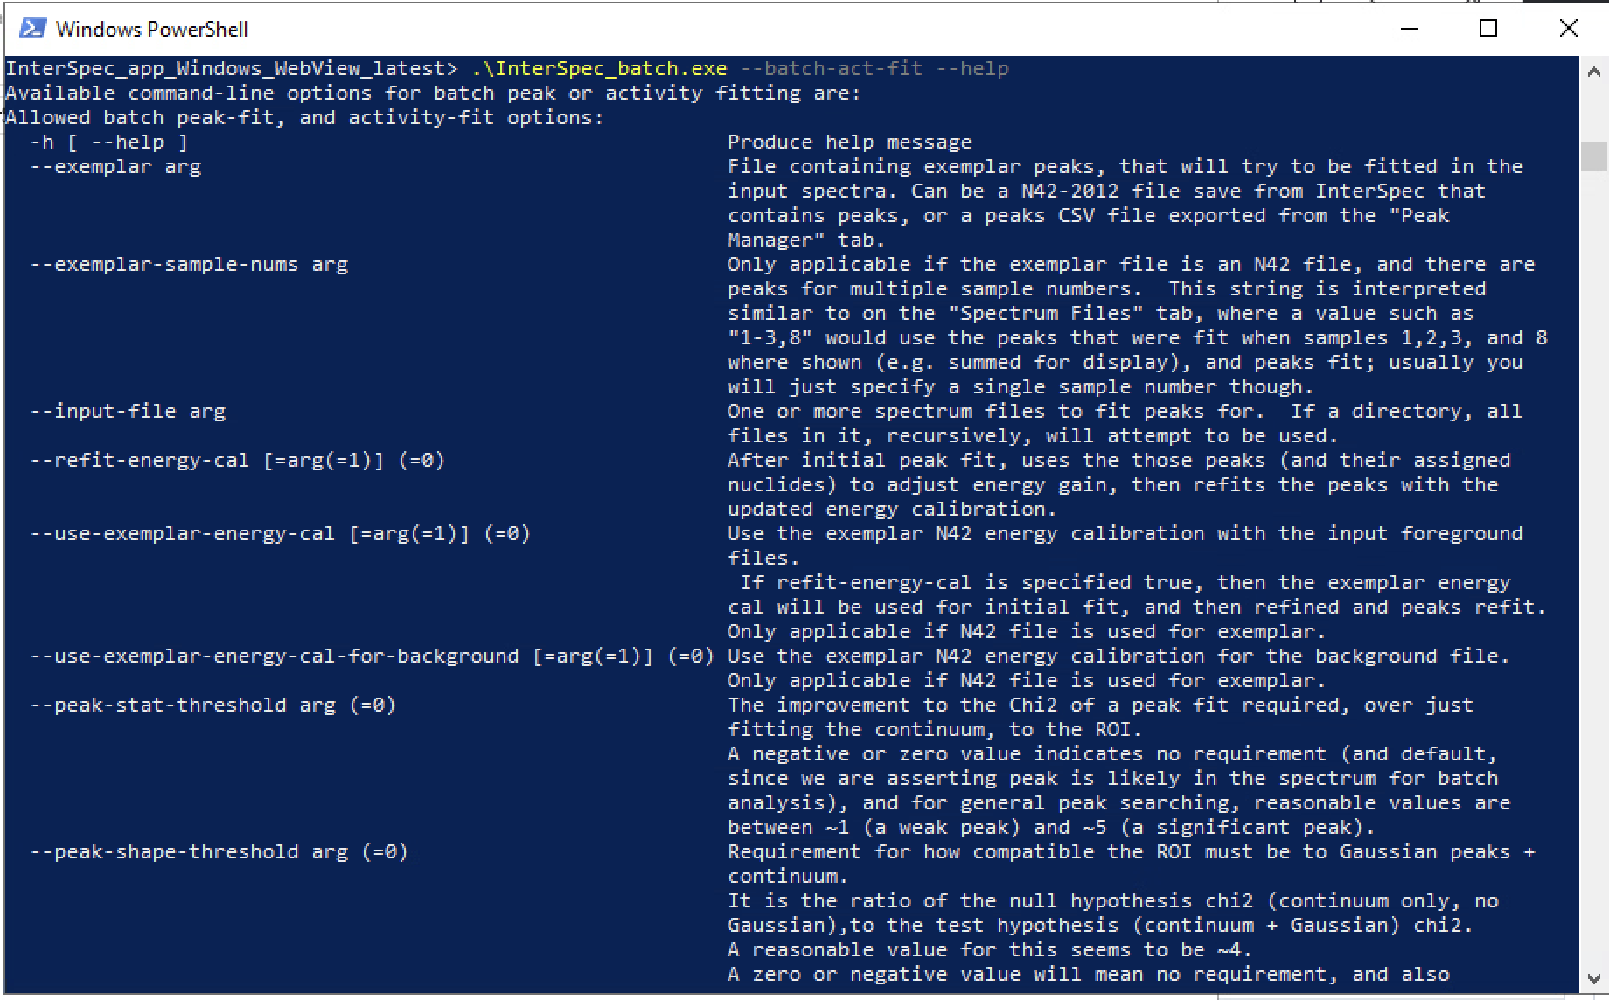
in-situ Example – Step 8: Run Batch Analysis (cont)
You will need to open up a terminal (Power Shell, or CMD on Windows, and Terminal.app or iTerm on macOS), and all following commands assume Windows, and you have cd’d to the same directory as the InterSpec_batch executable (but this isn't required – just for brevity)
There are a lot of options, and you can type “InterSpec_batch.exe --help” to get a list of options, and the specific one we are interested in is “--batch-act-fit”, so we can get help on this sub-option using: InterSpec_batch.exe --batch-act-fit --help

Slide 20
in-situ Example – Step 8: Run Batch Analysis (cont)
If you read through the options, the options we want to specify are:
--exemplar “\Path\To\Exemplar.n42”
This is the N42 file we exported in step 7
--use-exemplar-energy-cal
This says to use the energy cal we fit in the exemplar, for each of the input foreground files
--input-file \Path\To\Input\location*.n42
This uses a wildcard (*) to specify all the input files to be analyzed. You could instead type out each one individually
--out-dir \Path\To\Results\Output
This is the directory to place the results in – it must already exist

Slide 21
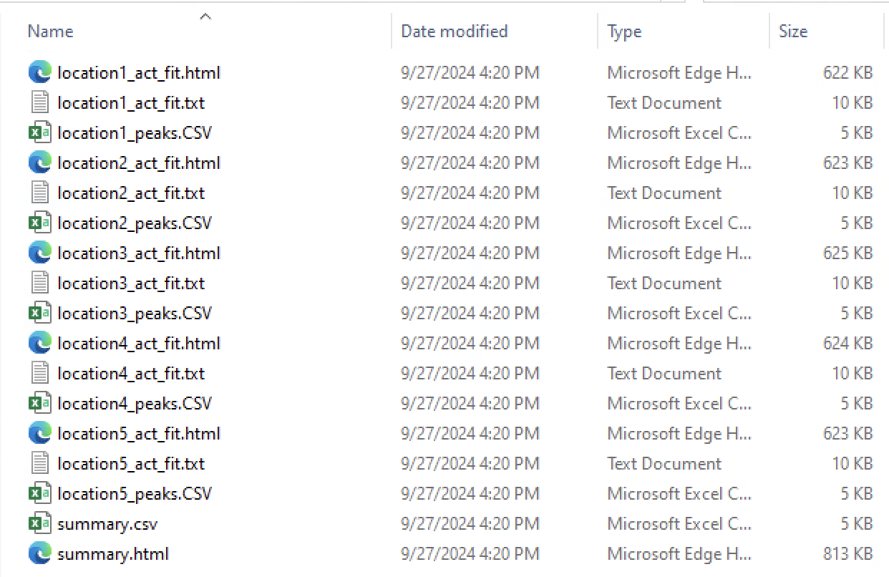
in-situ Example – Results
After running the command, you should see contents similar to the above in your specified output directory.
There is both a HTML and TXT result for each input file
And there is a summary HTML and CSV file
What gets output can be customized – will briefly cover later

Slide 22
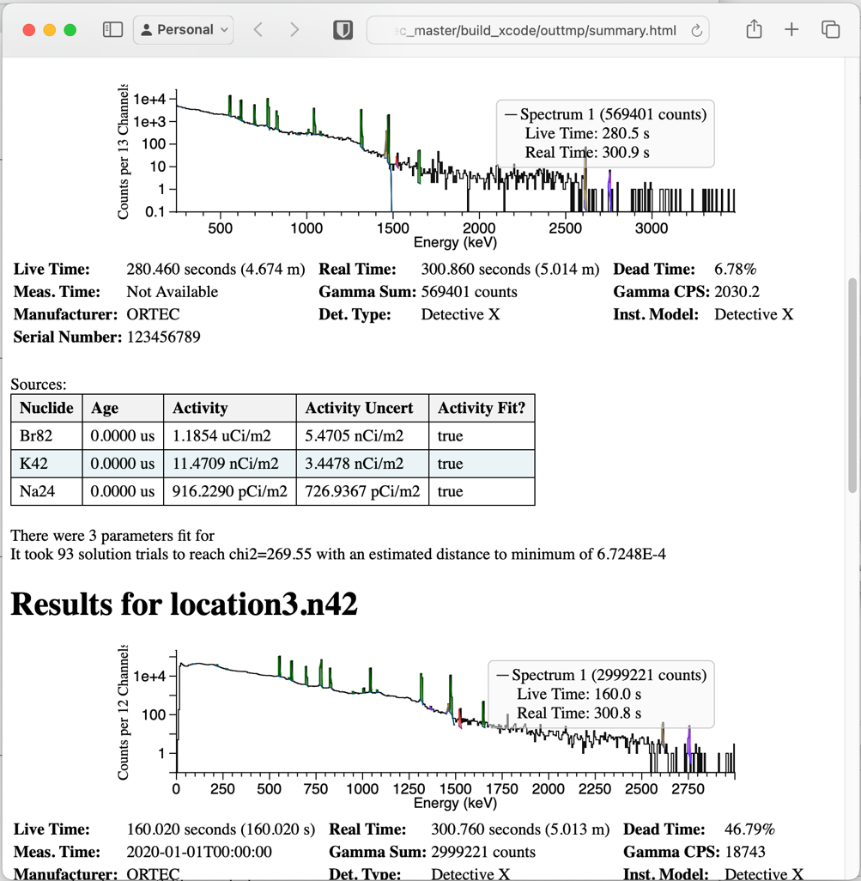
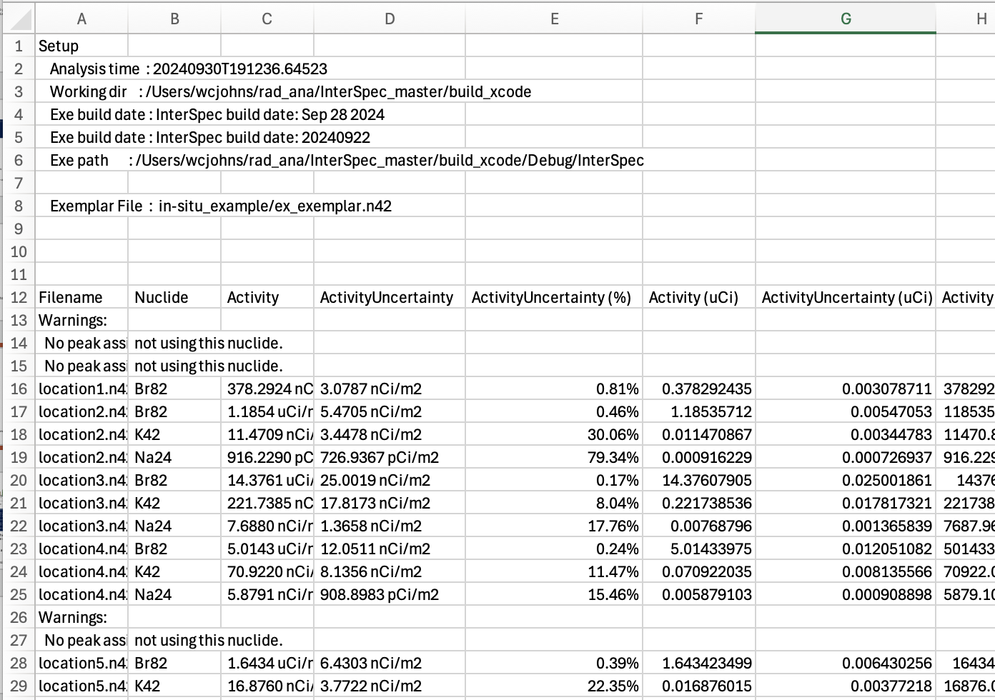
in-situ Example – Initial Results
The HTML files all contain interactive spectra (you can zoom in/out), showing peak fits, and some basic summary information
CSV summary file contains just activities
HTML/TXT files for individual files contain more information than the summary files

Slide 23
in-situ Example – Comparison to Genie2k
Location | Nuclide | InterSpec Act. (µCi/m²) | Genie2k Act. (µCi/m²)
1 | Br82 | 0.378292 | 0.383800
3 | Br82 | 14.376079 | 14.270000
 | K42 | 0.221739 | 0.205800
4 | Br82 | 5.014340 | 5.038000
 | K42 | 0.070922 | 0.067150
5 | Br82 | 1.643423 | 1.641000
A standard FRMAC analysis sequence was used with Genie2k, using the same detector efficiency, to compare activities
Activities below a pre-set detection threshold not shown
There was an error analyzing location 2 in Genie2k, so it is not shown
Key lines were used in G2K, but weighted average of peak used in InterSpec
Results the same, within expectations

Slide 24
Additional Command Line Options
Command-line options you can read about if you “InterSpec_batch.exe --batch-act-fit --help”
help, ini-file, exemplar, exemplar-sample-nums, refit-energy-cal, use-exemplar-energy-cal, use-exemplar-energy-cal-for-background, peak-stat-threshold, peak-shape-threshold, back-sub-file, background-sample-nums, hard-background-subtract, use-existing-background-peaks, include-nonfit-peaks, out-dir, overwrite-output-files, write-n42-with-results, peak-csv-output, result-json-output, print, file-report-template, summary-report-template, report-template-include-dir drf-file, drf-name, distance, use-bq
The more notable options will be explained in the next few slides

Slide 25
Command Line Options – Peak Thresholds
The default peak threshold settings cause the 2754 keV Na24 peak of “location 5” file to not be fit
By default, InterSpec requires peaks to be something like 2 sigma significant, and to match the data better than just a continuum, but we can adjust these settings
--peak-stat-threshold
This is roughly stat significance improvement over just a flat continuum – but if you think of it as number of sigma significant the peak is, it is close-enough
--peak-shape-threshold
Ratio of null-hypothesis χ² (i.e., continuum only) to χ² of continuum + Gaussian

Slide 26
Command Line Options – More Useful Options
--overwrite-output-files
By default the output files wont be overwritten, if you run the analysis again, this option lets you overwrite them, in case you are running many times
--peak-csv-output
Write CSVs of the peaks fit for each input file – these are same CSV file you can download from the “Peak Manager” tab, or that can be saved from Peak Easy
--write-n42-with-results
Will write N42 files, with the fit peaks in them, for each input file; will eventually include the Act/Shield Fit setup
--use-exemplar-energy-cal, --use-exemplar-energy-cal-for-background
Use the exemplars energy calibration for the input foreground, and/or background
--refit-energy-cal
If specified, after fitting peaks (and if specified using exemplar energy cal), will fit the energy calibration coefficients - will then re-fit the peaks. Useful for small energy cal drifts during measurements, because the ROIs are defined by energy, so this helps in getting consistent ROI extents
--back-sub-file, --hard-background-subtract
If signal peaks overlap background peaks, you can account for this by specifying a background spectrum file. By default InterSpec will try to fit peaks in the background, and then do a peak-by-peak subtraction, unless you specify a “hard” background subtraction, then the background will be subtracted on a channel-by-channel basis

Slide 27
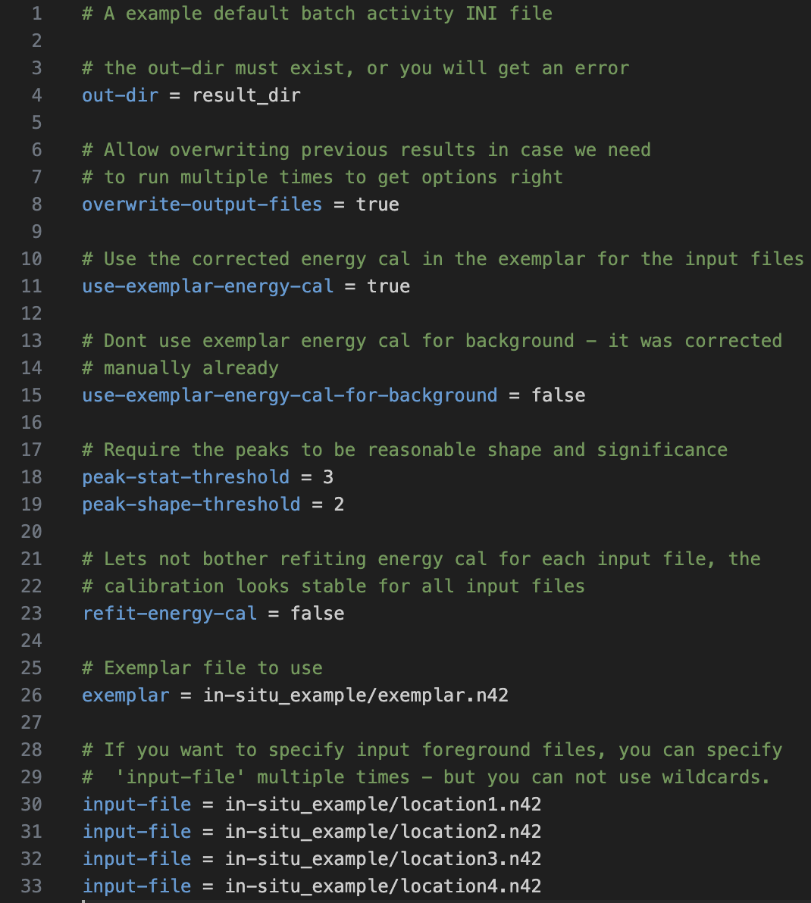
Using a INI file to Specify command-line arguments
Typing everything can be tedious, so you can instead use a combination of a INI file, and command-line options
Any option specified in the INI file, will be overruled if the option is specified on the command-line
If you save this file as “InterSpec_batch.ini” in your current working directory, it will automatically be used. Or you can specify the INI file explicitly like: “InterSpec_batch.exe --batch-act-fit --ini-file config.ini …”
You still need to specify “--batch-act-fit” on the command-line
You also probably want to specify “--input-file” on the command line, so you can use wildcard (*) to list many files easily
Using the INI file shown, the command would then be:
InterSpec_batch.exe --batch-act-fit --ini-file config.ini
Example config.ini file contents

Slide 28
Customizing Output reports
The output of the analysis can be highly customized
InterSpec uses the wonderful {{ inja }} templating library to create the output files; you can specify for InterSpec to use a template file that you choose.
For example, a simple template to make a CSV of the activity, of all files could be:
This loops over all input files, and prints a line for each fit nuclide, giving its activity and uncertainty, in uCi.
If you saved the above as my_summary.tmplt.csv, then you would specify to use it as: InterSpec_batch.exe --batch-act-fit --summary-report-template my_summary.tmplt.csv … And the output would be my_summary.csv in the specified output directory

Slide 29
Customizing Output reports (cont)
Full documentation of the templating language can be found at: https://github.com/pantor/inja
The input to {{ inja }} is JSON, that InterSpec creates during the calculation, and with the results.
You can save this JSON by specifying the --result-json-output argument, so you can then open up the JSON file, and see variables you want to use in the report template
Its then fairly straightforward to look for what you want in the JSON file, and use it within your custom template file
An absolute ton of information is saved into the JSON – but if anything has been missed you would like, please email InterSpec@sandia.gov
The default output from batch processing is created from the templates in InterSpec\InterSpec_resources\static_text\ShieldSourceFitLog\ You can probably start from these and just edit them to what you want

Slide 30
Summary
The “batch” version of InterSpec hopefully makes repetitive peak-fitting, or Activity/Shielding fitting less mundane.
As of October 2024, the feature should be considered to be in an “alpha” or preview state
We would greatly appreciate feedback, suggestions, or to hear your use-case to improve things – as well as any bugs or short-comings
The batch feature was implemented with a very minimal amount of resources, so there is likely some rough edges, bugs, and obvious omissions – please let us know about these
In the future, if support for implementation is found, we would like to:
Add a graphical interface, so if you drag a bunch of spectrum files into the InterSpec app, a batch tool will pop-up to perform the batch analysis in a little more user friendly way
Adding support the Isotopics from peaks/nuclide tools, as well as the flux, and detection limits
Add options to fit peaks of nuclides specified from the command line, as well as vary more options from the command line

Slide 31
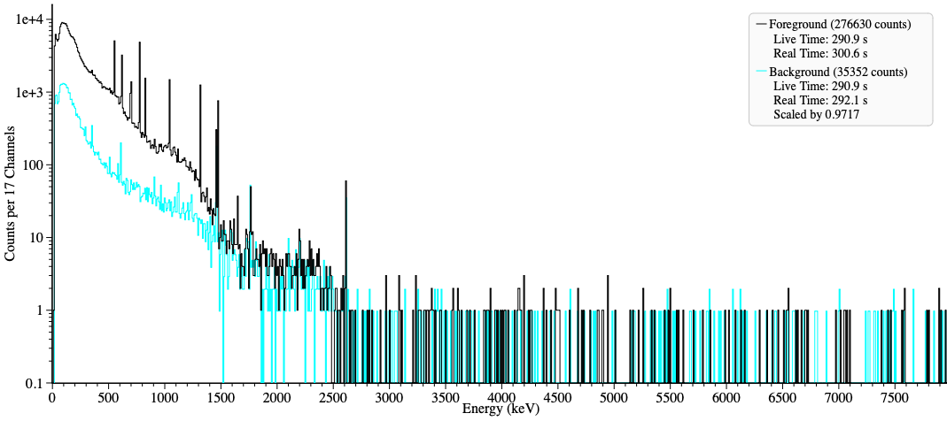
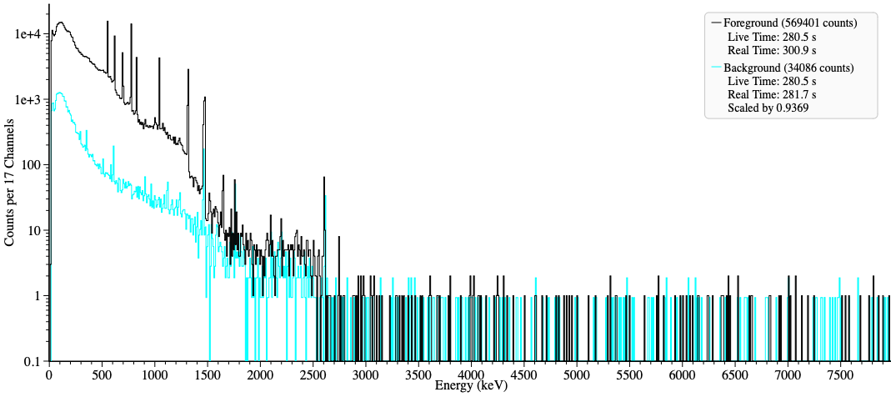
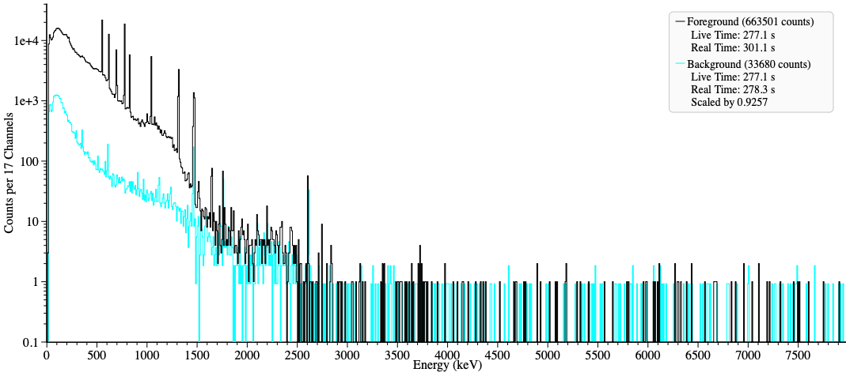
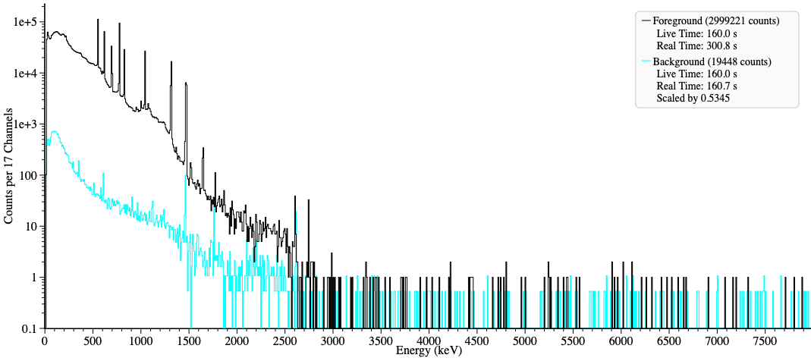
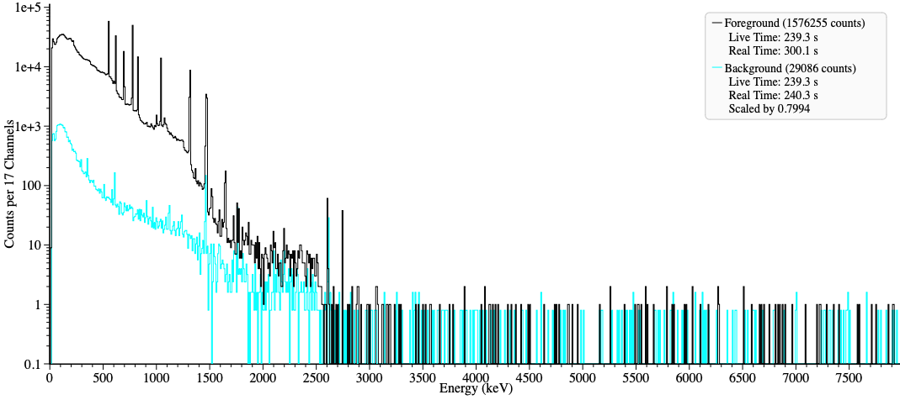
Spectra Included With this Presentation
Location[1-4].n42, and Background.n42: Spectra collected from ground contaminated with Br82 and K42, using a Detective-X, facing down, 1-meter from the ground

Slide 32
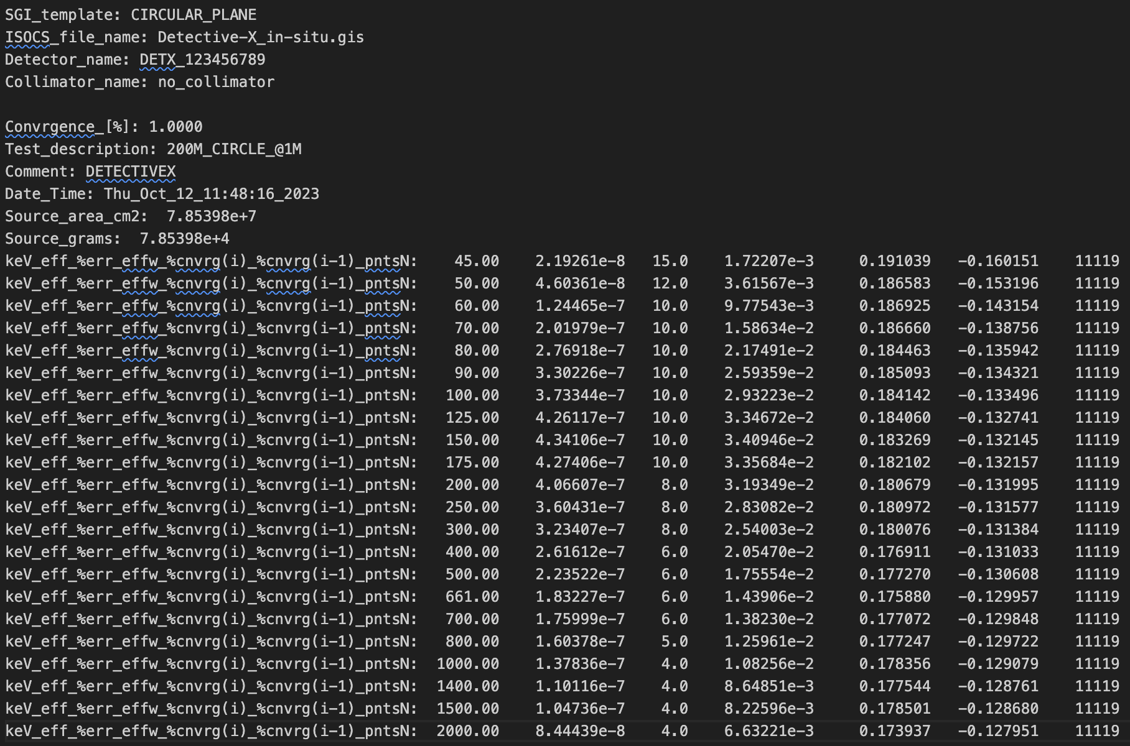
Detective-X_in-situ.ecc
The efficiency, as a function of energy, computed by Mirion ISOCS, for a Detective-X in-situ measurement

